Slide 1

Strategic Project and Risk Management
Risk Management Process
Dr. Richard Scudder Copyright 2018
<number>
Notes:
<number>
Motivation and connection items:
Risk assessment should be part of portfolio management, therefore part of strategic PM
Risk is best managed through knowledge of what works and what doesn’t work, which comes from good measurement (metrics)
Risk assessment should be one of the bases of requirements definition and early project/product testing

Slide 2

Agenda
Creating a Risk Plan
Project Risk Maturity Model
Analyzing and Planning for Risk
  SIPOC
  Quantitative Risk Measurement
  FEMA
  Risk monitoring and control
Program Level Risk
  Foreseeable risk and residual risk
  Project learning
Responding to Risk
Dr. Richard Scudder Copyright 2018
<number>

Slide 3
Strategic PM Roadmap
Effective Management
Processes
Portfolios
Programs
Projects
Defined Methods
Measure Results
Pilots
Baselines
Inputs
Management
Clients
Customers
Employees
Stakeholders
Measurement
Risks
KPIs
Metrics
Measurements
Estimates
Consensus
Dr. Richard Scudder Copyright 2018
<number>
Slide <number>

Slide 4

Risk Taking Cultures
Conscious
Unconscious
Inexperienced and unpracticed
Experienced and Practiced
Dr. Richard Scudder Copyright 2018
<number>

Slide 5
Amateurs
Inclination to take risks.
Experience, physique, and
equipment are imperfect.
Performance norms are short term.
Action is not accompanied by caution.
Lack of norms may allow the amateur to grab new,
unusual opportunities.
Under pressure, the amateur's ambition may turn
to foolhardiness.
The amateur does not receive all the signals - or
understand all of those received.
Dr. Richard Scudder Copyright 2018
<number>

Slide 6
Tourists
Lack experience and physique.
Planning and equipment are
deficient.
Can sometimes be tempted to take
risks, but often
give up.
There is a desire for risks, but not necessarily the
will to reach the goal.
There is no strategy or tactics - or they are the
wrong ones.
Signals go unnoticed or are incorrectly interpreted.
Dr. Richard Scudder Copyright 2018
<number>

Slide 7
Natives
Act in accordance with the
situation.
Act by reflex.
Signals are received and
interpreted.
A "do-it" culture.
Weakness often lies in commitment.
They may regard the goal with indifference.
Under pressure, the native will not take chances
and may abandon the team.
Dr. Richard Scudder Copyright 2018
<number>

Slide 8
Professionals
Inspire strategic thinking.
Economize on energy.
Do good preparation, planning.
Have good equipment, training.
Characterized by good
performance norms,
determination, and self-confidence.
On the way, reconnaissance is carried out and
attention is paid to signals, which are properly
interpreted.
Under pressure the professional will take up a
challenge, but will also set limits by underlining
what they know and what they don't know.
Dr. Richard Scudder Copyright 2018
<number>

Slide 9
Risk
Our approach to risk is often
determined by personal attitudes.
We must learn to approach risk
strategically, balancing and/or
overcoming personal attitudes as
necessary.
Planning is critical.
Dr. Richard Scudder Copyright 2018
<number>
Notes:
This is similar to Huillson/ Hopkinson’s Risk Maturity model: Naïve, Novice, Normalized, Natural
<number>

Slide 10
Why Do Risk Management?
Risk management:
  Helps define what projects are likely to be completed as expected and which are not
  Assists management and internal clients to manage portfolios by choosing which projects to fund, which to eliminate, and which to defer
  Gives your organization the ability to respond to internal and external challenges
  Risks must be managed at all levels – Project, Program and Portfolio
Dr. Richard Scudder Copyright 2018
<number>
Notes:
<number>
Motivation:
Metrics based risk management helps define how likely a project is to be successful
Contrast this approach with no risk assessment
Contrast this approach with guesstimates
Management and clients can make better decisions through having an accurate measure of risk
This means that portfolio decisions can be made and managed with some degree of assurance, rather than guessed at or hoped for
Use the example of a one dollar bill for auction. Slightly different auction – Both the last bidder and the final bidder have to pay. Starts at one cent. Often goes as high as $2.00 Illustrates our focus on sunk costs as well as not recognizing risk…

Slide 11


Risk Management
Planning
Risk
Management
Process:
Identification
Analysis
Mitigation
Monitoring
Dr. Richard Scudder Copyright 2018
<number>
Slide <number>
Notes:
<number>
The basics of risk management

Slide 12
Planning
Planning
Identification
Analysis
Mitigation
Monitoring
Entire process should be planned:
  How do you define risk?
  How is risk identified?
  What inputs, tools, techniques and outputs are expected?
  What are the procedures required?
  What documentation is required?
Dr. Richard Scudder Copyright 2018
<number>
Slide <number>
Notes:
<number>
As with project management, risk management should be planned, including how you define risk, as well as how you intend to deal with it once you have identified the risk areas.
Example: determine the riskiness of projects
“Portfolio managers and program managers assess confidence in project plans.” This best practice is achieved through a series of capabilities that an organization may develop incrementally:
1. Ability of portfolio managers and program managers to assess confidence in project plans.
2. Ability to confirm the availability of resources throughout critical paths necessary to achieve Work within allotted Duration for each project.
3. Ability to identify dependencies among all projects.
4. Ability to analyze the critical paths of all projects and to measure variance in the critical paths of all projects.
5. Ability to measure variation in activity duration values for all projects.
6. Ability to develop best, worst, and most likely estimates for durations of all tasks of each project.
7. Ability to estimate duration and work for each project.
8. Ability to develop a WBS dictionary for each project.
9. Ability to confirm the scope of work for each project with the project sponsors and project customers.
10. Ability to understand the business drivers, constraints, and assumptions for each project.
Dependencies exist among these capabilities. Capability 1 depends on 2, which depends on 3, which depends on 4, which depends on 5, which depends on 6, which depends on 7, which depends on 8, which depends on 9, which depends on 10. Such dependencies constitute a recommended sequence for developing the capabilities incrementally within an organization to achieve this best practice, i.e. 10, 9, 8, 7, 6, 5, 4, 3, 2, 1 in this example. Within a system of capabilities like these, small actions can have large, measurable effects. But failure to recognize a dependency can result in false starts or significant delays.
John Schlichter, “Project Portfolio Management and The Organizational Project Management Maturity Model ,” pmforum.org

Slide 13
Identification
Planning
Identification
Analysis
Mitigation
Monitoring
Use a list of categories or the WBS to help define the risks to a project.
  Then define the risks to each specific project.
Create a list of key risks associated with typical projects.
  Define the key risks for the current project(s).
Dr. Richard Scudder Copyright 2018
<number>
Slide <number>
Notes:
<number>
Rick management plans should be developed in parallel with PM plans. The back and forth of the development of each of these plans will shed light on the other.
Key to Risk ID is identification of the tasks to be done in the project (from the WBS) or a generic set of risk categories which are explored to find where the risks lie in this project.

Slide 14

Identifying Risk
Key Risk Identification:
  Global projects
  Project Size
  Project Complexity
  Resource Availability
  Client Experience with Similar Projects
  Use of New Technologies, Processes, Tools
  Contract Type
Dr. Richard Scudder Copyright 2018
<number>
Slide <number>
Notes:
<number>
Key risk factors

Slide 15
Identifying Risk
Key Project Risk Area: Work Breakdown Structure
  Look at each work package for:
    Project Time
    Cost
    Quality
    Criteria issues
  Define contingency plans and reserves for each part of the package.
Dr. Richard Scudder Copyright 2018
<number>
Slide <number>
Notes:
<number>

Slide 16
Analysis
Planning
Identification
Analysis
Mitigation
Monitoring
Order the set of risks.
Assess each against a set of criteria:
  Probability
  Magnitude
  Impact on the project
Select the most appropriate means of reducing each risk.
Dr. Richard Scudder Copyright 2018
<number>
Slide <number>
Notes:
<number>
Once the risks are IDed, then rank the risks and assess how to deal with them.

Slide 17

Analysis
Determine if each risk should be accepted or mitigated.
Design a mitigation plan.
Ensure that the courses of action chosen do not create unintended consequences.
Present the risk plan to clients and management.
Resource the risk plan.
Dr. Richard Scudder Copyright 2018
<number>
Slide <number>
Notes:
<number>
Continue the analysis.
Sanity check your conclusions.
Develop and implement the risk mgmt plan.

Slide 18
Mitigation
Planning
Identification
Analysis
Mitigation
Monitoring
Communicate the risk plan effectively. Ensure progress against the risk plan.
Coordinate the risk plan with other parts of the organization.
Update the risk plan as needed.
Resolve resource allocation conflicts promptly.
Dr. Richard Scudder Copyright 2018
<number>
Slide <number>
Notes:
<number>

Slide 19
Monitoring
Planning
Identification
Analysis
Mitigation
Monitoring
Watch for new risk areas, and follow the process to prepare risk plan steps.
Capture lessons on the effectiveness of the risk management plan. Feedback results for subsequent risk plans.
Check risk management indicators on a regular basis.
  Use a dashboard or scorecard
  Use a spreadsheet
Dr. Richard Scudder Copyright 2018
<number>
Slide <number>
Notes:
<number>
Keep track: as risks occur, does the PM team need to take action?
If so, what and when?
Multinational companies that are project driven need to be especially aware of project risk. Too often, management looks at this as simply an over management expense in the project.
You are getting better and better at PM
Customers give you more and more work
Now you are doing turnkey projects
Your customers worry less about your PM – you have taken responsibility
To manage costs, you begin outsourcing to other orgs…but their PM now becomes your responsibility. Have you quantified that risk? What if they don’t perform? What if they don’t understand PM or Risk management?
EDS looks at this as absolutely critical. An informed risk plan with a clear process can be a great clearing ground for working with these sub-contractors. Reviews give you a chance to bring up problems in a less threatening environment.

Slide 20

Risk Management Process
Iterative – returned to throughout each project.
Continuous throughout projects – not just during planning.
Feedback looped – use lessons learned to improve future projects.
Dr. Richard Scudder Copyright 2018
<number>
Slide <number>
Notes:
<number>
Risk management info should be developed over time, so that risks from prior projects can be factored into current projects, including the estimates.
Be prepared to manage risk all through the project
Pay attention to both technical and behavioral perspectives
Implement it in a top-down, bottom up manner Use it to inform PM … make sure some one is assigned to manage it.
Use appropriate measures…simple to moderately complex depending on the issues…but don’t over complicate it.
Tailor risk management to the project … one size does not fit all

Slide 21
Risk Management
Engineering
Project Management
Quality Control
Risk Management
Schedule
Estimates and Costs
Dr. Richard Scudder Copyright 2018
<number>
Notes:
<number>
Risk management within the overall project framework

Slide 22


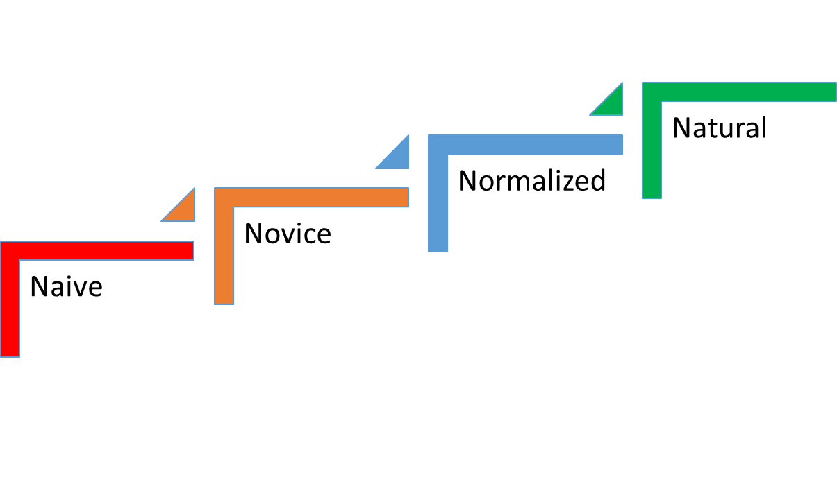
A Risk Maturity Model
Organizational culture is risk- aware and proactively built into all aspects of the business. Risk information used to improve business processes and gain competitive advantage.
Risk Management processes built business processes and most projects implement risk management. Formalized and widely used in organization
Experimenting with risk management, but no formal structure or processes
Unaware of Need for Risk Management. Processes mostly reactive
Dr. Richard Scudder Copyright 2018
<number>
- David Hilson, “Towards a Risk Maturity Model”

Slide 23
Achieving Risk Maturity
In practice, moving to maturity level 2 can be achieved by applying a risk management process such as the simple risk register we will talk about in the next session.
Moving from level 2 to 3 requires that a risk management process be implemented consistently across projects and that skill is acquired in using risk management tools.
Dr. Richard Scudder Copyright 2018
<number>

Slide 24
Achieving Risk Maturity
A key enabler of maturity level 3 is regular risk reviews that enforce disciplined use of risk management tools
Organizations with more large projects may find moving to level 3 more difficult
Dr. Richard Scudder Copyright 2018
<number>

Slide 25
Maturity Level 4
At this maturity level, risk is managed strategically. Projects or project solutions are chose with risk in mind: risk choices can effectively choose which projects move forward and how specific projects are carried out.
Dr. Richard Scudder Copyright 2018
<number>

Slide 26
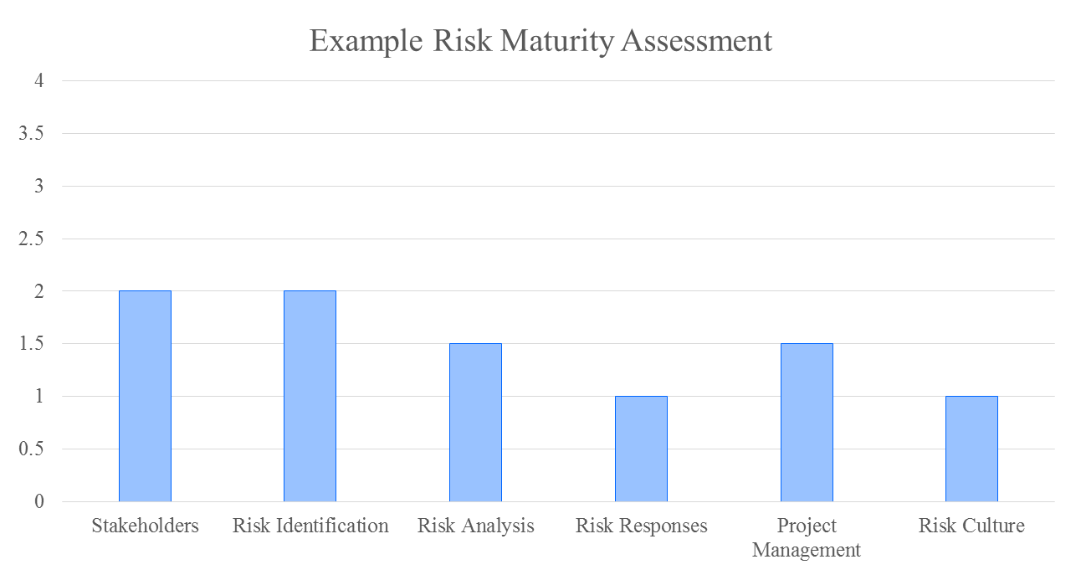
Areas Effecting Risk Maturity
Dr. Richard Scudder Copyright 2018
<number>
Notes:
A defense equipment company prime contractor procurement contract, and was both larger and more complex than other projects. The chart shows an assessment of the Prime Contractor’s risk management capability towards the latter stages of development and early stages of production. A fixed price contract for these two phases had been won in a competitive tender. The government organization that was the Prime Contractor’s customer had required a risk register to be included in the proposal. However, the submitted risk register was, in essence, a subtle part of the contractor’s sales pitch. There was an emphasis on risks that competitors were more exposed to and a use of warm words and optimistic assessments to downplay any other risks that the customer could be assumed to have identified. For the first two years after contract placement, there had been no further use of risk management. However, important assumptions about the maturity of existing designs had turned out to be unfounded, and as a consequence, timescales had started to slip at an accelerating rate. At this point, there was a change in company ownership. This resulted in at least three initiatives to make more formal use of a risk management process. First, the new finance director introduced a requirement for contingencies to be justified with calculations based on a risk register. In some circumstances, this might have prompted improved practice. However, the accepted basis for these calculations was simplistic. Moreover, the project team could quantify the board’s expectations of project contingency. In practice, the project manager contrived a list of plausible risks with estimates to match these expectations. In a second initiative, another director hired an external consultant to conduct a quantitative schedule analysis for completing the development phase. However, when the results of this analysis were published, management at all levels considered the forecasts to be so pessimistic that the modelling must be wrong. All the report’s recommendations were then quietly forgotten. As it would turn out, actual schedule performance proved to be much worse. As the condition of the project grew progressively worse, efforts were made to use the risk register to identify and manage actions for risk mitigation. Unfortunately these efforts lacked true support from the project manager. Risk reviews were invariably cancelled in favor of new emergencies. Support for the process was similarly lacking from the other organizations involved, including the customer and the major subcontractor. There was general reluctance on the part of the project leaders to tackle risks at source. To do so it would have been necessary to admit to past mistakes. Survival in project management jobs required a style that combined energetic fire fighting with the type of cunning that enables people to forecast success and then avoid blame for failure. The development phase of this project eventually slipped by more than three years: doubling the original plan. The case illustrates a number of symptoms that may be associated with Level 1 risk management capability. Forecasts from a cost risk analysis designed to fulfil a director’s expectations can be worse than useless. If the calculations are unnecessarily high, the project manager is liable to either spend unnecessarily or claim disproportionate credit for their performance. More commonly a director’s expectations will be optimistic. If the risk calculations are optimistically biased in response, the owning organization will have late notice of financial issues The company’s accountants were later forced to back trade the project’s contribution to profits. But, perhaps the most important lesson to be learned is that an effective risk management process requires continuous and constructive support from managers at all levels. The project had the knowledge and resources to manage risk much more effectively, but the benefits of this were never realized.
<number>

Slide 27


Case Study
Dr. Richard Scudder Copyright 2018
<number>

